Slide 1

LINUX

Slide 2
Soumya Gupta (152915)
Introduction
Linux subsystem
Aastha Verma (152537)
Kernel
Booting Process
Jabbireddy Gireesha (152659)
File subsystem
Naredla Gangavamshi (152851)
Shell
Process Management
Samiti Rahul (152907)
Device Management
Memory Management

Slide 3

INTRODUCTION
Notes:
O Logo de espadas deve ter mais espaço das pontas abaixo. Sugerir outros tipos de imagens/ telefone, fones.

Slide 4

What is Linux ?
Linux is the open source operating system.
It is Multi-user, Multitasking and Multiprocessor.
Coexists with other operating systems.
Runs on multiple platforms.

Slide 5
ADVANTAGES
Cost
Stability
Compatibility
Free to do what you like
Virus free
Network support
Security
Has short debugging time

Slide 6
History of Linux
1984 - Richard Stallman starts GNU project.
1987- MINIX was first released which inspired creation of Linux.
1991 - Linus Torvalds writes 1st version of Linux kernel.
1992 - released the kernel under GNU.

Slide 7


Open Source Software
It is software with source code that anyone can inspect, modify and enhance.
Open source software is different from free
software. All free software are not open source software.
Open source is a philosophy, that promote free redistribution and access to end product design and implementation details.
The word free in OSS refers freedom not the cost.

Slide 8

Advantages of open Source software
Availability of source code.
Does not depend on vendors.
Quality in open source
software is better.
Lesser hardware cost.

Slide 9
Disadvantages of Open Source Software
Not easy to use and requires a certain learning curves.
Incompatibility issue with software and hardware (3rd party drivers).
Bad codes and some unqualified people uses it.
Less support available when things go wrong.
Less user friendly.

Slide 10

Linux Distribution
It is an operating system made from a software collection, which is based upon the Linux kernel and often a package management system.

Slide 11
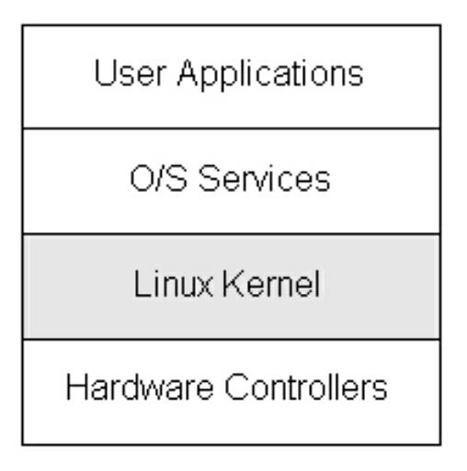
Linux Subsystems
Subsystem is a self-contained system within a larger system.
Linux subsystem includes :
User Applications – Applications used by end users for processing.
Shell – An interface to kernel, hiding complexity of kernel functions from users. Takes commands from user and executes kernel functions.
Kernel – Core component of Operating System, interacts directly with hardware, provides low level services to upper layer components.
Hardware layer – It consists of all peripheral devices (RAM, HDD, CPU etc).

Slide 12

KERNEL
Notes:
O Logo de espadas deve ter mais espaço das pontas abaixo. Sugerir outros tipos de imagens/ telefone, fones.

Slide 13
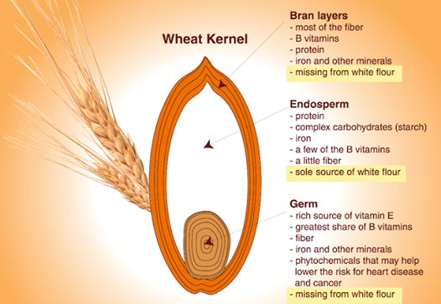

Literal Definition
A softer, usually edible part of a nut, seed, or fruit stone contained within its shell.
The central or most important part of something. “This is the kernel of the argument”.

Slide 14
Formal Definition
A kernel is the foundational layer of an operating system (OS).
It functions at a basic level, communicating with hardware and managing resources, such as RAM and the CPU.
It is the part of the operating system that loads first, and it remains in main memory. Because it stays in memory, it is important for the kernel to be as small as possible while still providing all the essential services required by other parts of the operating system and applications.

Slide 15
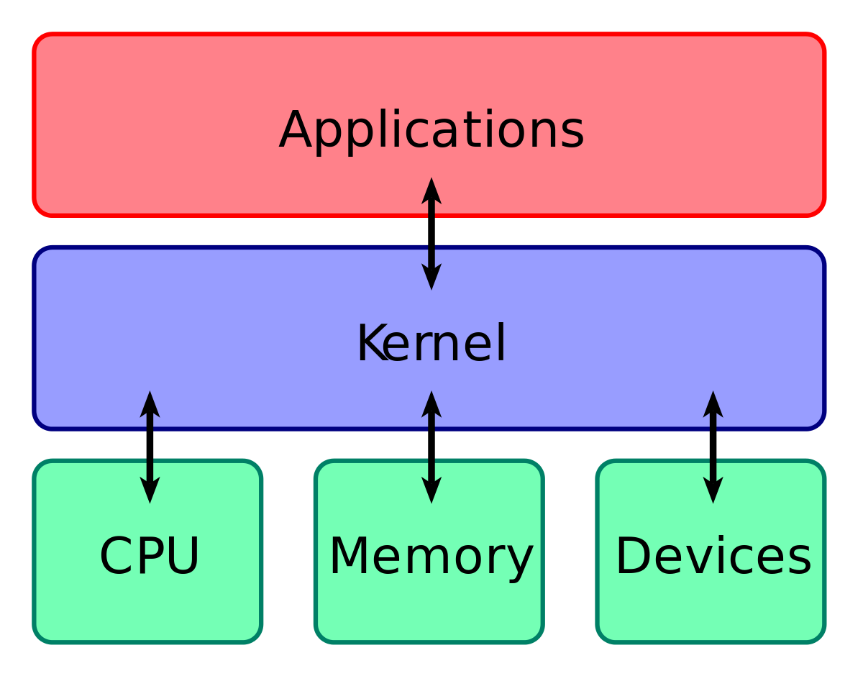
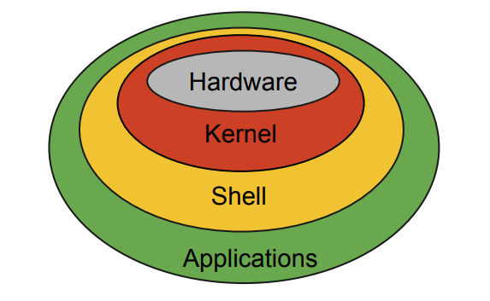
BASIC STRUCTURE

Slide 16
Basic Facilities : CPU
This central component of a computer system is responsible for running or executing programs. Often multiple programs will want access to memory, frequently demanding more memory than the computer has available.
The kernel is responsible for deciding which memory each process can use, and determining what to do when not enough memory is available.
RESOURCE
MANAGEMENT

Slide 17
Basic Facilities : Memory (RAM)
RAM is used to store both program instructions and data. Typically, both need to be present in memory in order for a program to execute.
The kernel takes responsibility for deciding at any time which of the many running programs should be allocated to the processor or processors.
MEMORY
MANAGEMENT

Slide 18
Basic Facilities : Devices
I/O devices include such peripherals as keyboards, mice, disk drives, printers, USB devices, network adapters, and display devices.
The kernel allocates requests from applications to perform I/O to an appropriate device and provides convenient methods for using the device (typically abstracted to the point where the application does not need to know implementation details of the device).
DEVICE
MANAGEMENT

Slide 19
TYPES OF KERNEL
Monolithic Kernel
User services and kernel, services are kept in same address space.
Slow execution.
Monolithic kernel is larger than microkernel.
If a service crashes, the whole system crashes in monolithic kernel.
To write a monolithic kernel, less code is required.
Micro Kernel
User services and kernel, services are kept in separate address space.
Fast execution.
Microkernel are smaller in size.
If a service crashes, it does effect on working of microkernel.
To write a microkernel, more code is required.
Notes:
Fixar a posicao do titulo – sempre do lado esquerdo.
Sempre que tiver muito texto o coluna deve sempre ser “ narrowed” , se nao fica dificil de ler. Colocar paragrafos no texto.
Linha vertical deve ser mais fina e as pontas NUNCA devem ser arredondadas.

Slide 20
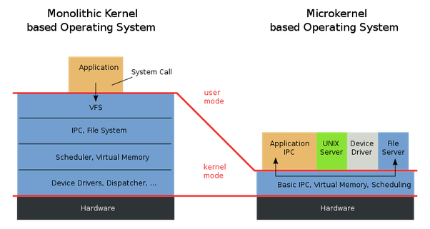
User Space – Space in memory where user applications are executed.
Kernel Space – Space in memory where
kernel processes run. The user has access to it only through system calls

Slide 21
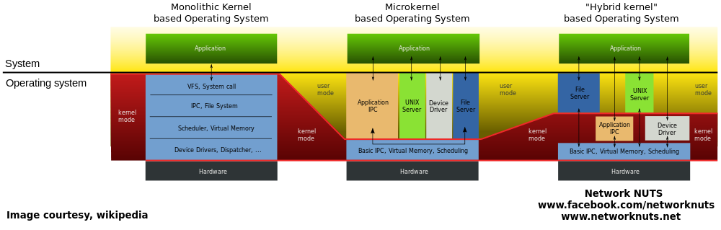

Slide 22
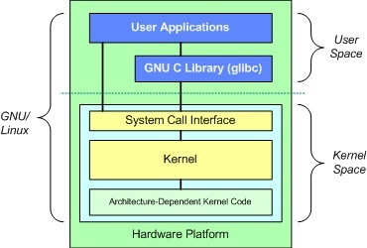
LINUX KERNEL
Linux kernel is a monolithic kernel
USER SPACE COMPONENTS :
User applications
glibc : Provides the system call interface that connects to the kernel : transition mechanism between user-space and kernel.
Each user space process occupies its own virtual address space (vs the kernel which runs on the single address space)

Slide 23
KERNEL SPACE COMPONENTS :
System Call Interface : provides the basic functions such as read() and write().
Kernel
Architecture-independent kernel code.
Common to all processor architectures supported by Linux.
Architecture-Dependent Code
Processor and platform specific code.
Also k/a Board Support Package

Slide 24
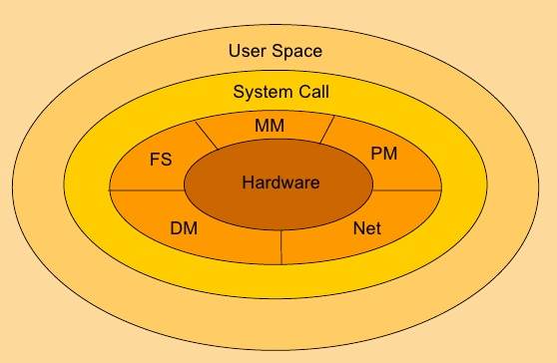
Kernel Subsystems
PS (or SCHED) – Process Scheduler
MM – Memory Manager
VFS – Virtual File System
DM – Device Manager
NET – Network Interface
IPC (System Call) – Inter Process Communication subsystem.
V
S

Slide 25
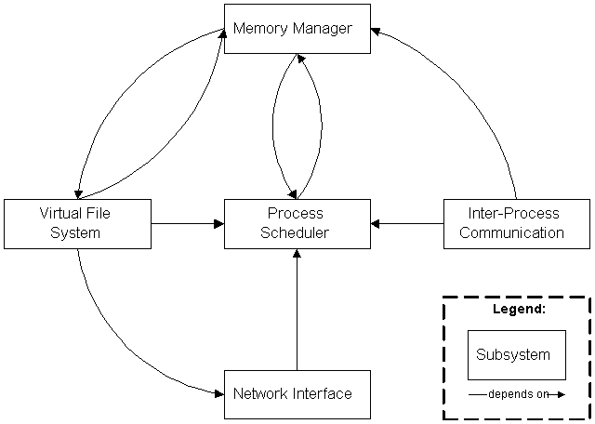
The Inter-Process Communication (IPC) subsystem supports several mechanisms for process-to-process communication on a single Linux system.

Slide 26
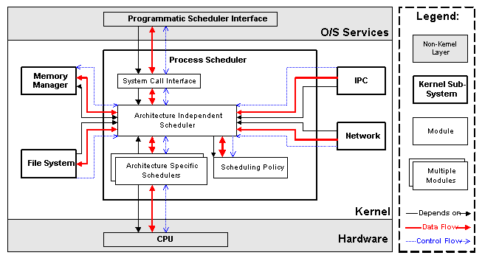
Process Scheduler (SCHED)
The Process Scheduler
(SCHED) is responsible for controlling process access to the CPU. The scheduler enforces a policy that ensures that processes will have fair access to the CPU, while ensuring that necessary hardware actions are performed by the kernel on time.

Slide 27
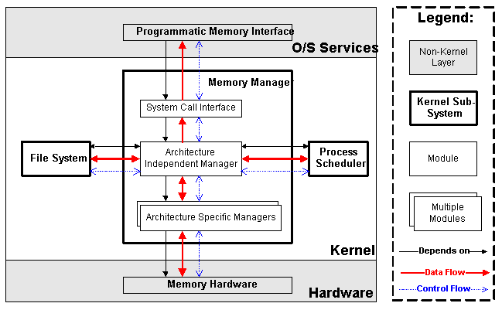
Memory Manager (MM)
The Memory Manager (MM) permits multiple process to securely share the machine's main memory system. In addition, the memory manager supports virtual memory that allows Linux to support processes that use more memory than is available in the system. Unused memory is swapped out to persistent storage using the file system then swapped back in when it is needed.

Slide 28
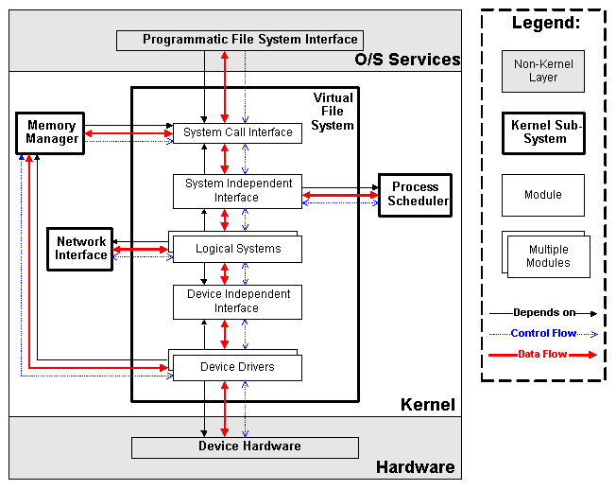
Virtual File System (VFS)
The Virtual File System (VFS) abstracts the details of the variety of hardware devices by presenting a common file interface to all devices. In addition, the VFS supports several file system formats that are compatible with other operating systems.

Slide 29
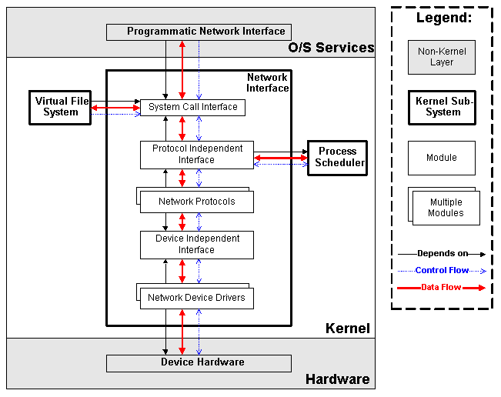
Network Interface (NET)
The Network Interface (NET) provides access to several networking standards and a variety of network hardware.

Slide 30
BOOTING
PROCESS
Notes:
O Logo de espadas deve ter mais espaço das pontas abaixo. Sugerir outros tipos de imagens/ telefone, fones.

Slide 31
LINUX BOOTING PROCESS
BIOS
System Startup/Hardware initialization
MBR
Boot loader Stage 1
GRUB
Boot loader Stage 2
Kernel
Linux OS (executes /sbin/init)
INIT
User Space Ready (starts Run Level)
RunLevel
Start scripts in dir /etc/rc.d/rc*.d/

Slide 32
1. BIOS
BIOS stands for Basic Input/Output System
Performs some system integrity checks
Searches, loads, and executes the boot loader program.
It looks for boot loader in floppy, cd-rom, or hard drive. You can press a key (typically F12 of F2, but it depends on your system) during the BIOS startup to change the boot sequence.
Once the boot loader program is detected and loaded into the memory, BIOS gives the control to it.
So, in simple terms BIOS loads and executes the MBR boot loader.

Slide 33
2. MBR
MBR stands for Master Boot Record.
It is located in the 1st sector of the bootable disk. Typically /dev/hda, or /dev/sda
MBR is less than 512 bytes in size. This has three components
1) primary boot loader info in 1st 446 bytes
2) partition table info in next 64 bytes
3) mbr validation check in last 2 bytes.
It contains information about GRUB (or LILO in old systems).
So, in simple terms MBR loads and executes the GRUB boot loader.

Slide 34
3. GRUB
GRUB stands for Grand Unified Bootloader.
If you have multiple kernel images installed on your system, you can choose which one to be executed.
GRUB displays a splash screen, waits for few seconds, if you don’t enter anything, it loads the default kernel image as specified in the grub configuration file.
GRUB has the knowledge of the filesystem (the older Linux loader LILO didn’t understand filesystem).
Grub configuration file is /boot/grub/grub.conf (/etc/grub.conf is a link to this).

Slide 35
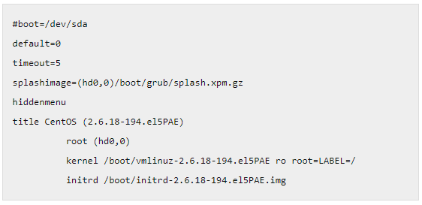
sample grub.conf of CentOS.
As you notice from the above info, it contains kernel and initrd image.
So, in simple terms GRUB just loads and executes Kernel and initrd images

Slide 36
4. Kernel
Mounts the root file system as specified in the “root=” in grub.conf
Kernel executes the /sbin/init program
Since init was the 1st program to be executed by Linux Kernel, it has the process id (PID) of 1. Do a ‘ps -ef | grep init’ and check the pid.
initrd stands for Initial RAM Disk.
initrd is used by kernel as temporary root file system until kernel is booted and the real root file system is mounted. It also contains necessary drivers compiled inside, which helps it to access the hard drive partitions, and other hardware.

Slide 37
5. INIT
Looks at the /etc/inittab file to decide the Linux run level.
Following are the available run levels :
0 – halt
1 – Single user mode
2 – Multiuser, without NFS
3 – Full multiuser mode
4 – unused
5 – X11
6 – reboot

Slide 38
5. INIT
Init identifies the default initlevel from /etc/inittab and uses that to load all appropriate program.
Execute ‘grep initdefault /etc/inittab’ on your system to identify the default run level
If you want to get into trouble, you can set the default run level to 0 or 6. Since you know what 0 and 6 means, probably you might not do that.
Typically you would set the default run level to either 3 or 5.

Slide 39
6. Runlevel Programs
When the Linux system is booting up, you might see various services getting started. For example, it might say “starting sendmail …. OK”. Those are the runlevel programs, executed from the run level directory as defined by your run level.
Depending on your default init level setting, the system will execute the programs from one of the following directories.
Run level 0 – /etc/rc.d/rc0.d/
Run level 1 – /etc/rc.d/rc1.d/
Run level 2 – /etc/rc.d/rc2.d/
Run level 3 – /etc/rc.d/rc3.d/
Run level 4 – /etc/rc.d/rc4.d/
Run level 5 – /etc/rc.d/rc5.d/
Run level 6 – /etc/rc.d/rc6.d/

Slide 40
6. Runlevel Programs
Under the /etc/rc.d/rc*.d/ directories, you would see programs that start with S and K.
Programs starts with S are used during startup. S for startup.
Programs starts with K are used during shutdown. K for kill.
Numbers right next to S and K in the program names : sequence number in which the programs should be started or killed.
S12syslog : start the syslog deamon, which has the sequence number of 12.
S80sendmail is to start the sendmail daemon, which has the sequence number of 80.
(So, syslog program will be started before sendmail)

Slide 41
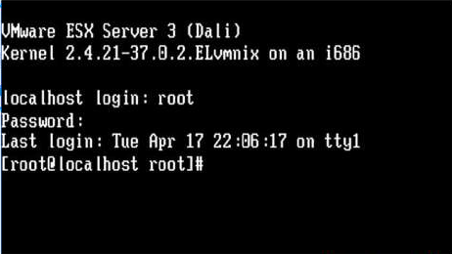
Final step : LOGIN

Slide 42
SHELL
Notes:
O Logo de espadas deve ter mais espaço das pontas abaixo. Sugerir outros tipos de imagens/ telefone, fones.

Slide 43
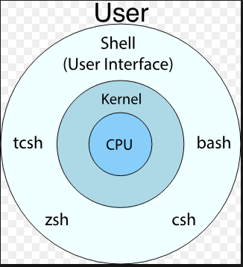
SHELL
A Shell is a computer program that interface between user and Unix like operating System
The command you type in command line is understood and interpreted by program and gives the desired output after execution of your command.
The program that understand your command is called Shell.
Types of shells
Ash shell
Bash shell
Korn shell
T-shell
C-shell
Z-shell

Slide 44
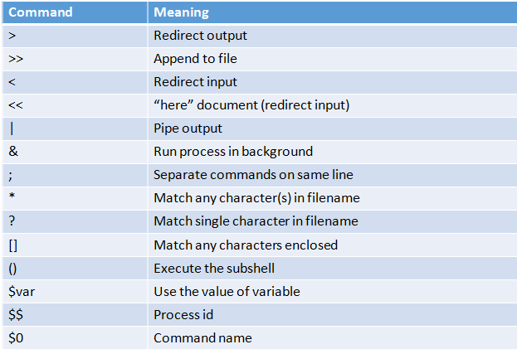
Common features of Shell

Slide 45
Environment variables
Environment Variables are dynamic values which affect the processes or programs on a computer.
They exit in every operating System ,but types may vary.
Environment variables can be created, edited, saved, and deleted and give information of system behavior.
Some important environment variables in Linux
PATH
PWD
LANG
USER
HOME
SHELL

Slide 46
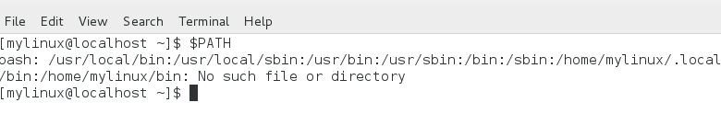
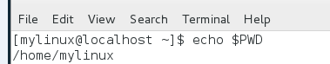
Environment Variables
PATH : This variable contains a colon(:)- separated list of directories in which your system looks for executable files. When you enter a command on terminal, the shell looks for the command in different directories mentioned in the $PATH variable, if the command is found, it executes. Otherwise, it return with an error.
HOME : Default path for user home directory
PWD : Prints current working directory

Slide 47
Process Management
Notes:
O Logo de espadas deve ter mais espaço das pontas abaixo. Sugerir outros tipos de imagens/ telefone, fones.

Slide 48
Process Management
Process : An instance of program is called process. Any Command we execute on Linux terminal creates a new process.
An Operation System can trace the process using the process id (pid)
Pid is unique for each process in the Operating System.
Types of Process :
Child Process : Process that is created by another Process ie Parent process during runtime is called child process. Each child process is created to do specific operation . A process can have many child Process but child can have only one parent process.
Daemon Process : A Daemon is a type of program on Unix-like operating systems that runs unobtrusively in the background, rather than under the direct control of a user, waiting to be activated by the occurrence of a specific event or condition

Slide 49
Process Management
Zombie Process : A Zombie Process is a process that should be closed but still present in the process table due to parent process is busy in doing some other job . The process which is waiting in the process table to get confirmation by the Parent process is called a Zombie Process.
Orphan Process : Orphan Process is a process whose parent process has finished or terminated but it still running itself. In Unix this process is adopted immediately by the INIT system process. Though it as parent but its original parent is terminated it is called Orphan Process.
Interactive Process : The process that interact instantly with user and therefore spending a lot of time for key passes and mouse operations.
Batch process : The process that frequently executed with minimum human interaction. Batch process jobs can run without any end-user interaction or can be scheduled to start up on their own as resources permit

Slide 50
Types of Scheduling :
Normal : It referred to as other, this is the scheduling type set for normal programs
FIFO : The term FIFO means First In First Out . The process which comes first is served first.
Round Robin : In this Scheduling time slice will be there so each process run that time slice period and wait until total process completes the execution of time .the Process continue until total processes complete the execution
SJF(shortest job first) : In this Scheduling , the process which has shortest burst time will execute first.
Priority Based Scheduling : In this Scheduling , the process which has highest priority execute first than the lowest priority Process

Slide 51
Inter Process Management
It is a set of techniques for the exchange of data among multiple in one or more processes.
Types of Inter Process Management :
Signals : sent by other processes or the kernel to a specific process to indicate the various conditions
Pipes : It special character “|” to route output of one program as input to other program
Socket : A socket is one end point to two way communication link between two programs running on the network

Slide 52
Inter Process Management
Message Queue : It is the mechanism that allows one or more process to write the message that can viewed by one or more process
Semaphore :A semaphore is a synchronization object that controls access by multiple processes to a common resource in a parallel programming environment. Semaphores are widely used to control access to files and shared memory. The three basic functionalities associated with semaphores are set, check and wait until it clears to set it again.
Shared Memory : The amount of mapping area is shared by multiple process.

Slide 53
File
Subsystem
Notes:
O Logo de espadas deve ter mais espaço das pontas abaixo. Sugerir outros tipos de imagens/ telefone, fones.

Slide 54
WHAT IS FILE?
A file is a collection of data stored in one unit, identified by a filename. It can be a document, picture, audio or video stream, data library, application, or other collection of data. Files can be opened, saved, deleted, and moved to different folders. They can also be transferred across network connections or downloaded from the Internet.
WHAT IS DIRECTORY?
A directory is another name for a folder. File systems use directories to organize files within a storage device.
Directories are two types:
Root directory,
Sub directory.

Slide 55
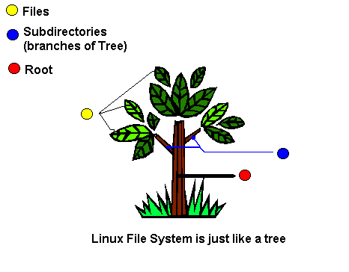
ROOTDIRECTORY:
The root directory is the top-level directory of a file system. The directory structure can be visually represented as an upside-down tree, so the term "root" represents the top level. All other directories within a volume are "branches" or subdirectories of the root directory. It is typically labeled simply / (a single forward slash).
SUBDIRECTORY:
Computers store data in a series of directories . Each directory, or folder, may contain files or other directories. If a directory is located within another directory, it is called a subdirectory.

Slide 56
WHAT IS LINUX FILE SYSTEM?
A file system controls how data is stored and retrieved. Without a file system, information placed in a storage medium would be one large body of data with no way to tell where one piece of information stops and the next begins. By separating the data into pieces and giving each piece a name, the information is easily isolated and identified.
File system contains:
The Boot Block
The boot block is usually a part of the disk label, a special set of blocks containing information on the disk layout. The boot block holds the loader to boot the operating system.

Slide 57
The Super Block
Each UNIX partition usually contains a special block called the superblock. The superblock contains the basic information about the entire file system.
I-Node
Information about each file in the filesystem is kept in a special kernel structure called an inode. The inode contains a pointer to the disk blocks containing the data in the file.
Data Block
The data blocks are where the data of a file is stored. These blocks follow the inode table and occupy most of the storage device's space.

Slide 58
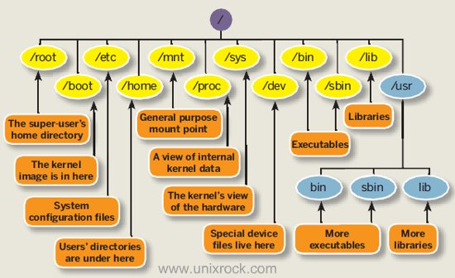
FILE SYSTEM HIERARCHY

Slide 59
IMPORTANT DIRECTORIES
/
/root
/boot
/home
/bin
/lib
/etc
/tmp
/dev
/usr

Slide 60
FILE & DIRECTORY NAMES
A filename is a name used to uniquely identify a computer file stored in a file system. Different file systems impose different restrictions on filename lengths and the allowed characters within filenames.
In computing, a directory is a file system cataloging structure which contains references to other computer files, and possibly other directories. On many computers, directories are known as folders.

Slide 61
ABSOLUTE & RELATIVE PATHNAME
An absolute path is defined as specifying the location of a file or directory from the root directory (/). In other words, we can say that an absolute path is a complete path from start of actual file system from / directory.
Relative path is defined as the path related to the present working directly (pwd). It starts at your current directory and never starts with a /.

Slide 62
CHANGING DIRECTORIES
To change directories from your current working directory, use the command cd. The above command changes directories to the /tmp/ directory. The second word on the command line must be a path. It can either be relative or absolute, and can move one directory or many.
Syntax: $ cd [option] [directory]
$ cd Returns you to your login directory
$ cd - Returns you to your previous working directory
$ cd ~ Also returns you to your login directory
$ cd / Takes you to the entire system's root directory.
$ cd /root Takes you to the home directory of the root user. You must be the root user to access this directory.
$ cd /home Takes you to the home directory, where user login directories are usually stored.
$ cd .. Takes you to the directory one level up.

Slide 63
LISTING DIRECTORY CONTENTS
ls is a Linux shell command that lists directory contents of files and directories.
Syntax: $ ls [options] [file|dir]
Eg:
$ ls -a list all files including hidden file starting with '.'
$ ls -d list directories - with ' */'
$ ls / List root directory.
$ ls .. List parent directory.
$ ls -la List with long format and show hidden files.
$ ls * List all subdirectories.

Slide 64
COPYING FILES & DIRECTORIES AND THE DESTINATION
The cp command will copy files and directories or copy multiple sources to a destination directory.
Syntax:
Copying Single file/dir:
$ cp [options] <source> <destination>
Copying Multiple files/dir:
$ cp [options] <source1 source2 [...]> <destination_directory>

Slide 65
Common options used with the cp command:
-a – archive, never follow symbolic links, preserve links, copy directories recursively.
-f – if an existing destination file cannot be opened, remove it and try again.
-i – prompt before overwriting an existing file.
-r – copy directories recursively.
Eg:
$ cp data.txt /var/tmp/ Copying a single file to a destination
directory.
$ cp data.txt file.csv /var/tmp/ Copying multiple files to a destination directory.
$ cp -r /etc/ /var/tmp/backup/ Copying a directory recursively.

Slide 66
RENAMING FILE & DIRECTORIES
The mv command is also used to rename items. You simply include the new file name in the location parameter.
Syntax:
$ mv [Option] <OldName> <NewName>
Eg:
$ mv test.txt testing.txt

Slide 67
CREATING FILES & DIRECTORIES
Creating Directories:
The mkdir command in LINUX allows users to create directories as they are referred to in some operating systems. The mkdir command can create multiple directories at once and also set permissions when creating the directory.
Syntax:
$ mkdir <directory_name>
Eg:
$ mkdir mydirectory

Slide 68
Creating Files:
The cat (“concatenate“) command is one of the most frequently used command in Linux/Unix like operating systems. cat command allows us to create single or multiple files, view contain of file, concatenate files and redirect output in terminal or files.
Syntax:
$ cat <File_name>
Eg:
$ cat myfile

Slide 69
NAUTILUS
Nautilus is a very popular file manager so if it isn’t installed for your particular distribution you should be able to find it in the graphical package manager.
Nautilus is the default file manager within Ubuntu Linux.
Nautilus is an open source file manager for the GNOME desktop that gives users a way to manage their files and applications. Nautilus can be used to do things like create folders and documents, display files and folders, search and manage files, and more.

Slide 70
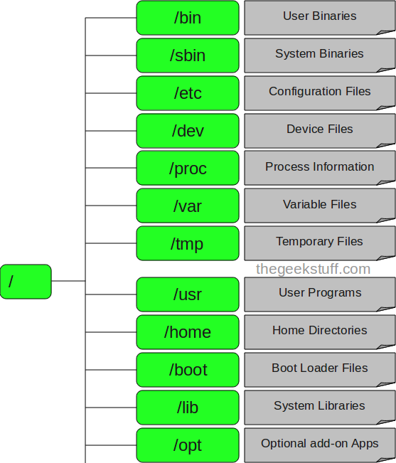
INTRODUCTION TO FILE STRUCTURE:
In the Linux file structure files are grouped according to purpose.
Ex: commands, data files, documentation. Parts of a Unix directory tree are listed below. All directories are grouped under the root entry "/". That part of the directory tree is left out of the below diagram.

Slide 71
DIRECTORIES IN A FILE STRUCTURE
Generally for arranging all the Files directories or Folders are used. A Folder or Directory is also called as the Container of the Files in which many Sub directors and Files are Stored. So that Files System Specifies the Arrangement of the Files in the System. There are following Directory Structures Available for organizing all the Files.
Available Directory Structures:
Hierarchical
Single Level Directory
Two Level Directory
Acyclic Graph Directory

Slide 72
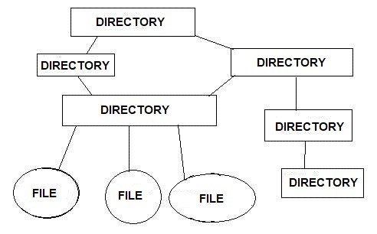
HIERARCHICAL:
In this all the Files are organized in the Form of Parent and Child Relationship. Means in this there is the Parent Directory which contains all the sub Files.

Slide 73
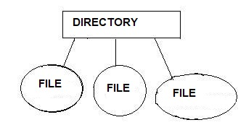
SINGLE LEVEL DIRECTORY:
In this there is a single directory which contains all the Files into. But this is not the best way because all the Files are Stored into the Single Folder So this is very difficult for a user to search a File. There is Only one Directory Which contains the other files So that Many times this is not used because this will Contains Huge Amount of Files and this will Makes difficult for the users to Locate or Find a File.

Slide 74
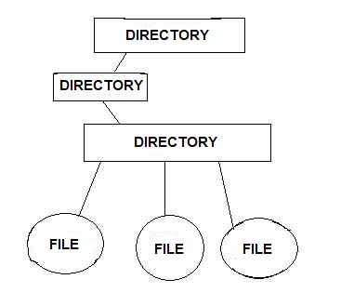
TWO LEVEL DIRECTORIES:
In this directory also contains a another directory and all the files are organized into the sub directory. In the two level a directory also contains sub directory and the files. We can say that a single directory will be the container of many other files and the directories so that when a user wants to access any directory then he has to travel all the other directories and files from that directory.

Slide 75
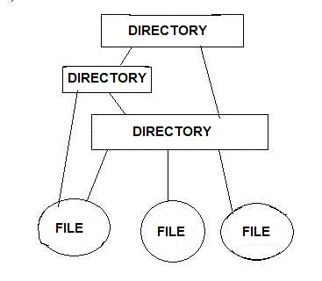
ACYCLIC GRAPH DIRECTORY
If a directory contains a directory and files then it is called as the acyclic directory in this a single directory contains both directory and files and all the directories are connected with some paths means a single folder or file can be accessible via another files.
In the acyclic graph a single file or a directory can be reached from any file because there are multiple path exists between that file.

Slide 76
Device
Management
Notes:
O Logo de espadas deve ter mais espaço das pontas abaixo. Sugerir outros tipos de imagens/ telefone, fones.

Slide 77
DEVICE FILES
Also called as Special File.
A device file allows to accesses hardware devices so that end users do not need to get technical details about hardware.
It is an interface for a device driver that appears in a file system as if were an ordinary file.
Allows software to interact with the device driver using I/O system calls, which simplifies many tasks.

Slide 78
Types of device files
Block device
Designed to operate in terms of block.
Has an associated block device driver that performs I/O by using file system block-sized buffers from a buffer cache supplied by kernel.
Ex: Hard disks, USB cameras, Disk-On-Key.
Character device
Designed to operate on a stream of characters, read from or written to it.
Has a character device driver associated with it, that can be used for a device like line printer that handles one character at a time.
Ex: Serial ports, parallel ports, sounds cards.

Slide 79
Block vs Character devices
Block device | Character device
Accessed by block-by-block. | Accessed in sequential order i.e., character-by-character.
Addressable in device specified blocks. | Not addressable.
Seeking is possible. | Seeking is not allowed.
Accessed through cache, so buffering is required. | No buffering.
More complex. | Less complex.
Hard drive, Pen drives. | Keyboard, Serial port.

Slide 80
Interrupt ReQuests (IRQ)
A hardware signal sent to the processor that temporarily stops a running program and allows a special program to run instead.
Auto-detecting IRQ number
Probing
Way for driver to determine which IRQ line to be used by device.
Driver tells device to generate interrupts.
Only one line should be activated.
probe_irq_on(void);
probe_irq_off(unsigned long);
These functions are used by the driver when it has to probe to determine what interrupt line is being used by a device. The result of probe_irq_on must be passed back to probe_irq_off after the interrupt has been generated. The return value of probe_irq_off is the detected interrupt number.

Slide 81
Interrupt Handler
A callback function in an operating system, or a device driver whose execution is triggered by the reception of an interrupt.
Initializing the IRQ interface
request_irq(unsigned int irq, void (*handler)(), unsigned long flags, const char *device, void *dev_id);
free_irq(unsigned int irq, void *dev_id);
These calls are used to register and unregister and interrupt handler.
Disabling Interrupts
When kernel doesn’t want to be interrupted
cli(void);
“Clear the Interrupts flag” – disable interrupts
sti(void);
“Set the Interrupts flag” – enable interrupts

Slide 82
Interrupt Handler split into two halves
“Top Half”
Scheduled immediately when an interrupt occurs.
Performs only the work that is time-critical, such as acknowledging receipt of the interrupt or resetting the hardware.
“Bottom Half”
Scheduled after the top half.
Executed at a safer time (because interrupts enabled).
mark_bh(int nr);
This function marks a bottom half for execution

Slide 83
Memory
Management
Notes:
O Logo de espadas deve ter mais espaço das pontas abaixo. Sugerir outros tipos de imagens/ telefone, fones.

Slide 84
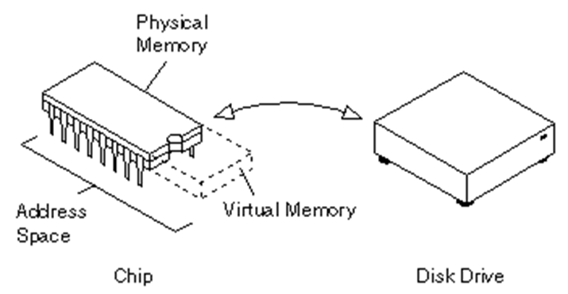
VIRTUAL MEMORY
The term ‘Virtual memory’ refers to something which appears to be present but actually it is not.
The virtual memory technique allows users to use more memory for a program than the real memory of a computer.

Slide 85
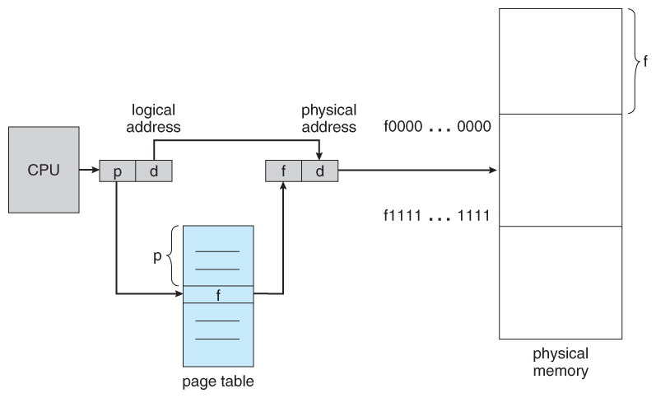
Page: Memory is divided into chunks of equal size called Page.
Page tables: The data structure used by a virtual memory system to store the mapping between virtual addresses and physical addresses.

Slide 86
Page Replacement Algorithms
Needed to decide which page needed to be replaced when new page comes in.
Whenever a new page is referred and not present in memory, page fault occurs and Operating System replaces one of the existing pages with newly needed page.
Types
LRU
Buddy

Slide 87
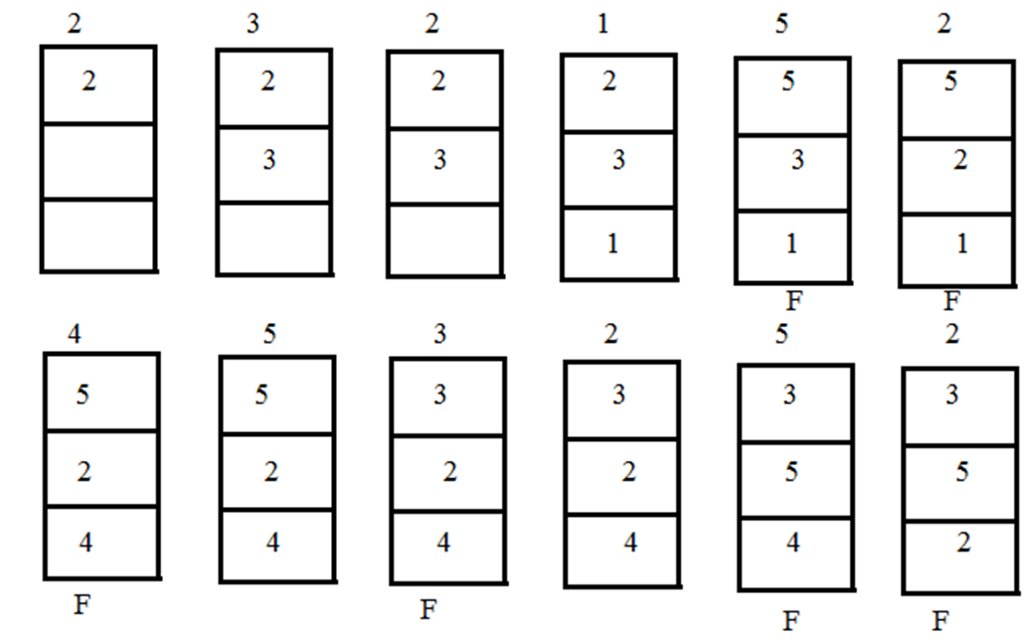
LRU
A least recently used page algorithm, keeps track of page usage over a short period of time.

Slide 88
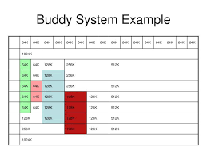
Buddy Algorithm
Invented in 1963 by Harry Markowitz.
A memory allocation algorithm that divides memory into partitions to try to satisfy a memory request as suitably as possible.

Slide 89
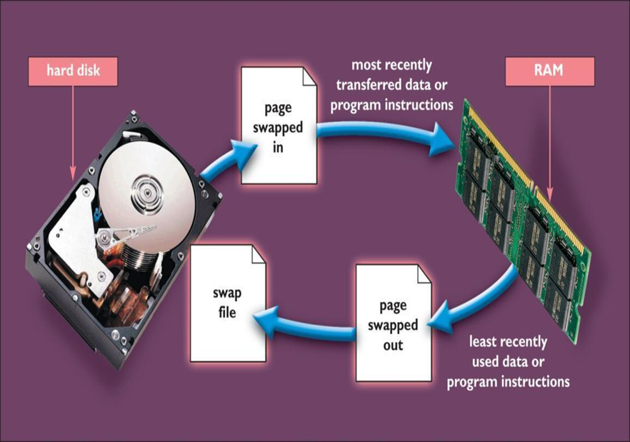
Memory Swapping
Interchanging the pages between physical memory and disk is called as Swapping.
The exact state or "page" of memory is copied to the disk to make the data contiguous and easy to restore later.

Slide 90
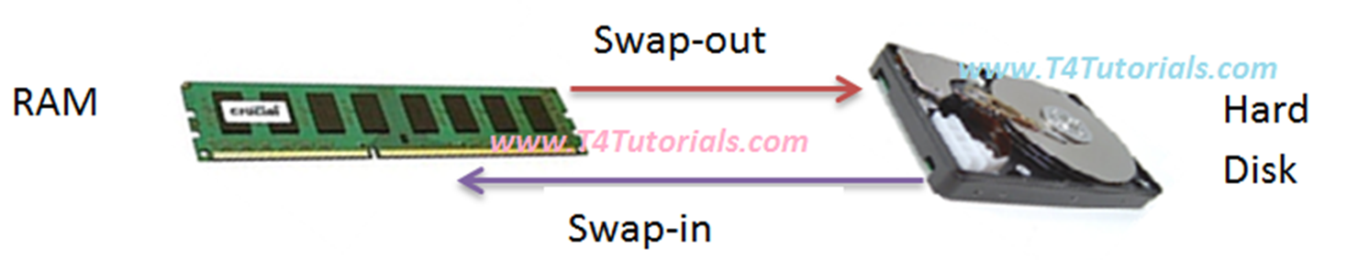
Swap-in
The process of writing pages out from physical memory to disk is called as Swap-in.
Swap-out
The process of loading pages from disk to physical memory is called as Swap-out.

Slide 91
THAT’s ALL FOLKS
Danke’

